Slide 1
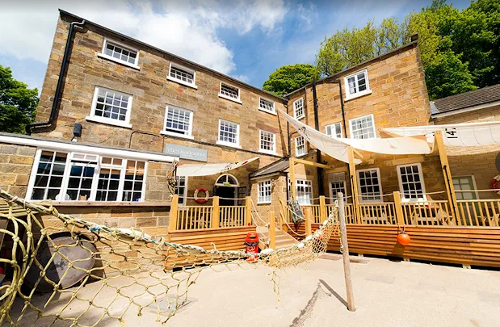
Boggle Hole
Information Meeting

Slide 2
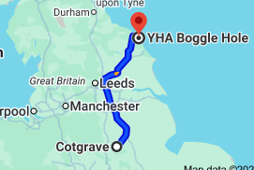
When and where?
Depart by coach: Wednesday 26th November (9am) – children will require a packed lunch on the day. This can be provided by school if your child is eligible for free school meals (please speak to your child’s class teacher to arrange this).
Arrive at YHA Boggle Hole in Whitby by approximately 12.30pm
Return by coach: Friday 28th November at approximately 4:00pm. We will send a message via the school office should we be running late for any reason or if we are likely to be slightly earlier.
YHA Boggle Hole, Mill Beck, Fylingthorpe, Whitby, North Yorkshire, YO22 4UQ, United Kingdom

Slide 3
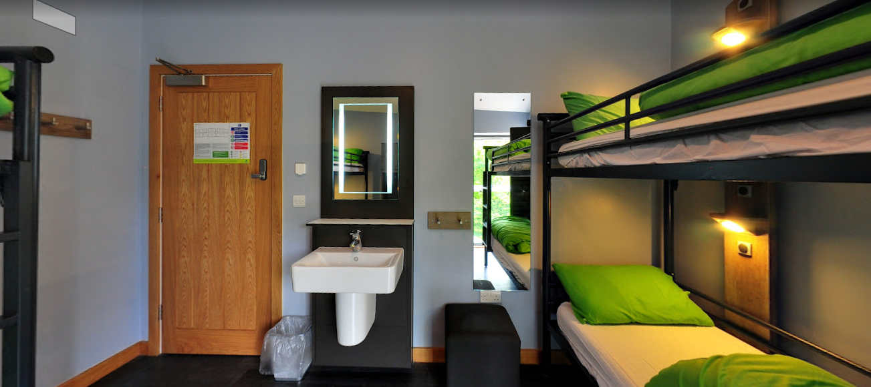
Accommodation
Boggle Hole has standard dormitory-style accommodation. Rooms range from 2 to 6 bed dormitories, with gender-separated bathrooms and shower facilities and party leader rooms close by. Sheets, duvets and pillows are provided for all guests.
Pupil room allocation will be organised by staff in school with requests being taken by the children as to who they would feel comfortable sharing a room with.

Slide 4
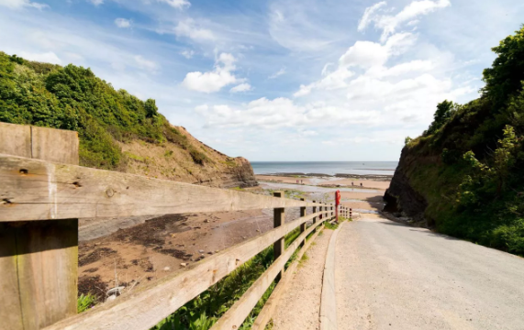
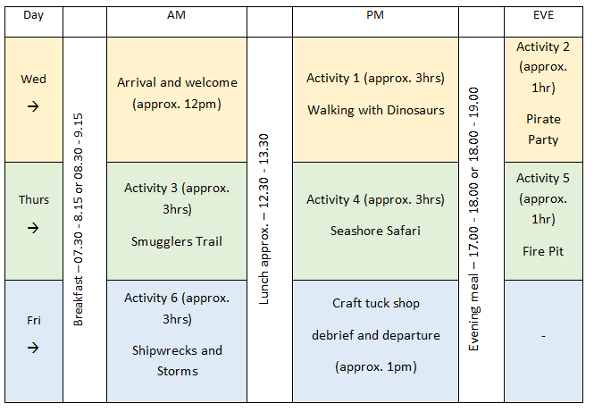
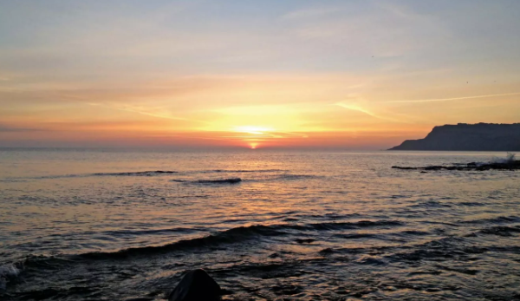
Activities:

Slide 5
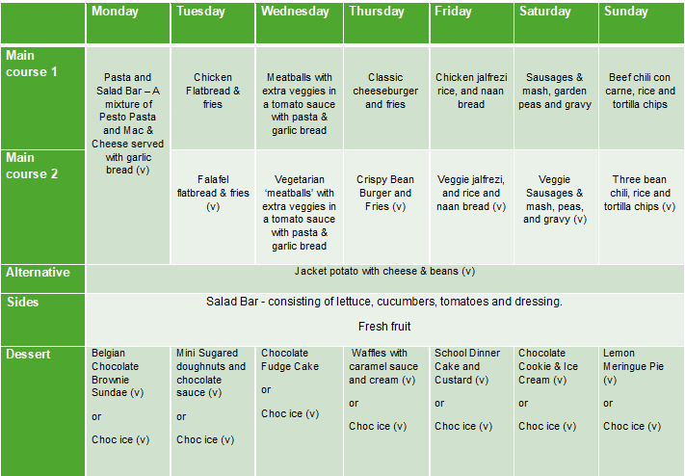
Food:
Children are provided with breakfast, lunch and evening meal each day. Boggle Hole offer a vast choice for each meal. Please ensure staff are aware of any dietary requirements that will need catering for.

Slide 6
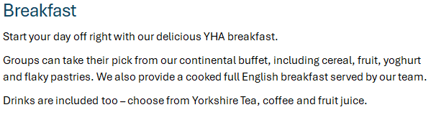
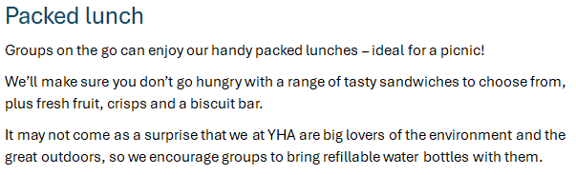
Food:

Slide 7
Packing list:
Wellies are essential for most activities – bring high wellies to Boggle Hole!
Waterproof jacket and if possible waterproof trousers
Woolly hat and gloves
Layers, layers and more layers (it is likely to be cold)
No designer labels or best clothes – the children will be getting muddy
Plenty of underwear and socks, just in case they end up getting wet
A change of trainer/indoor shoe for when in the building
Pyjamas and slippers (only if they want them)
Please label the items of clothing if possible – there will be a lost property box by the end of the trip!
A towel (or two) and toiletries including toothbrush and toothpaste
A water bottle
Anything pirate-related for the pirate party (optional)
£5 spending money for souvenirs, ice cream and rock
No electronic devices/mobile phones
We kindly ask that (where possible) large suitcases are not used as they are hard to store and transport with the number of pupils we have.

Slide 8

Medical Information
Please complete the medical information form
Please indicate if your child suffers from any nighttime incontinence/issues and we can discretely speak to the staff at Boggle Hole.
Please indicate if your child takes any travel sickness medication.
Please ensure all contact details are correct
Permissions to take photographs (Twitter page to update parents/carers when we are able to)
All medication must be clearly labelled and signed into school on Wednesday 26th November where it will be kept securely with first aid kit by school staff members.
We require all forms back ASAP please.

Slide 9
Thank you for your support!
Please let us know if you have any individual queries and we will be happy to help!
If you wish to stay and complete the medical forms now, you are welcome to. If not, please return to school by Tuesday 23rd September at the latest for risk assessment purposes.

